Slide 1
LE26-104 What's new: Enhanced subscription billing analytics
Kennie Nybo Pontoppidan

Slide 2
Business Value
Unified user experience
Analyze your subscription business the same way as for other areas
Notes:
LE25-100

Slide 3
Enhanced Subscription Billing Analytics (highlights)
Completely reworked Power BI reports
Better demo data

Slide 4
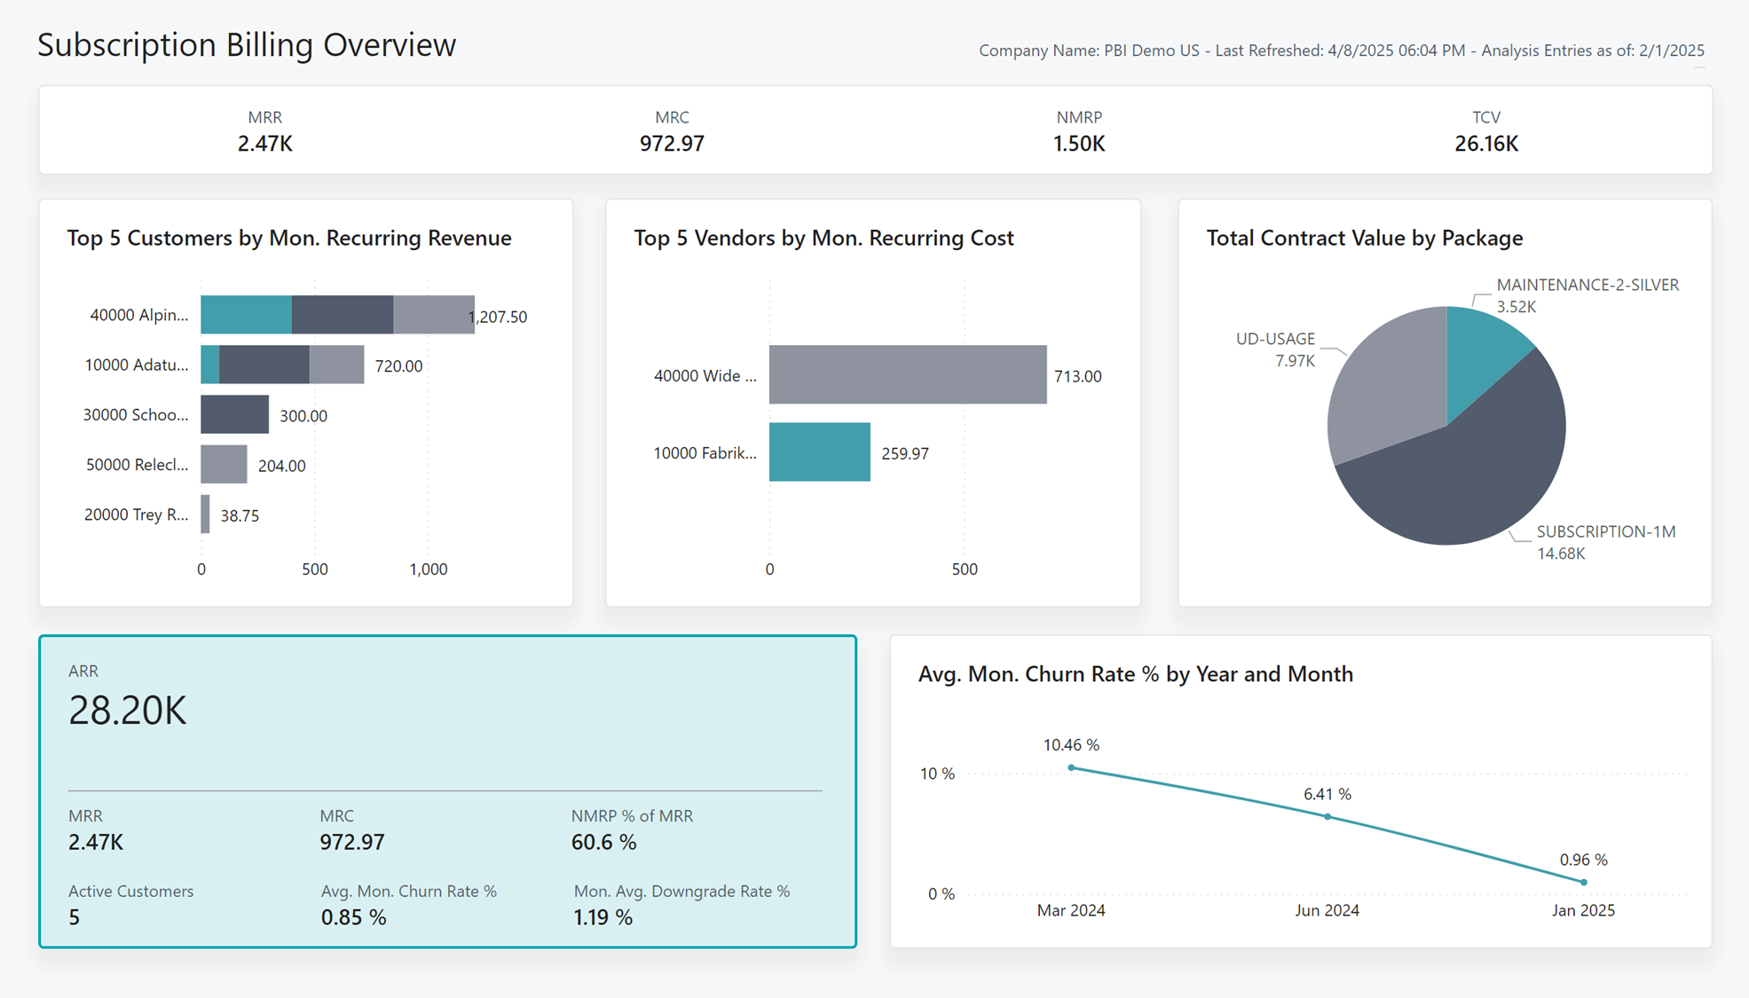
Completely reworked all Power BI reports

Slide 5
Updated Subscription Billing Power BI reports
Subscription Billing Overview
Revenue Year-Over-Year
Revenue Analysis
Revenue Development
Churn Analysis
Revenue by Item
Revenue by Customer
Revenue by Salesperson
Total Contract Value YOY Growth
Total Contract Value Analysis
Customer Deferrals
Vendor Deferrals
Revenue Forecast
Billing Forecast

Slide 6
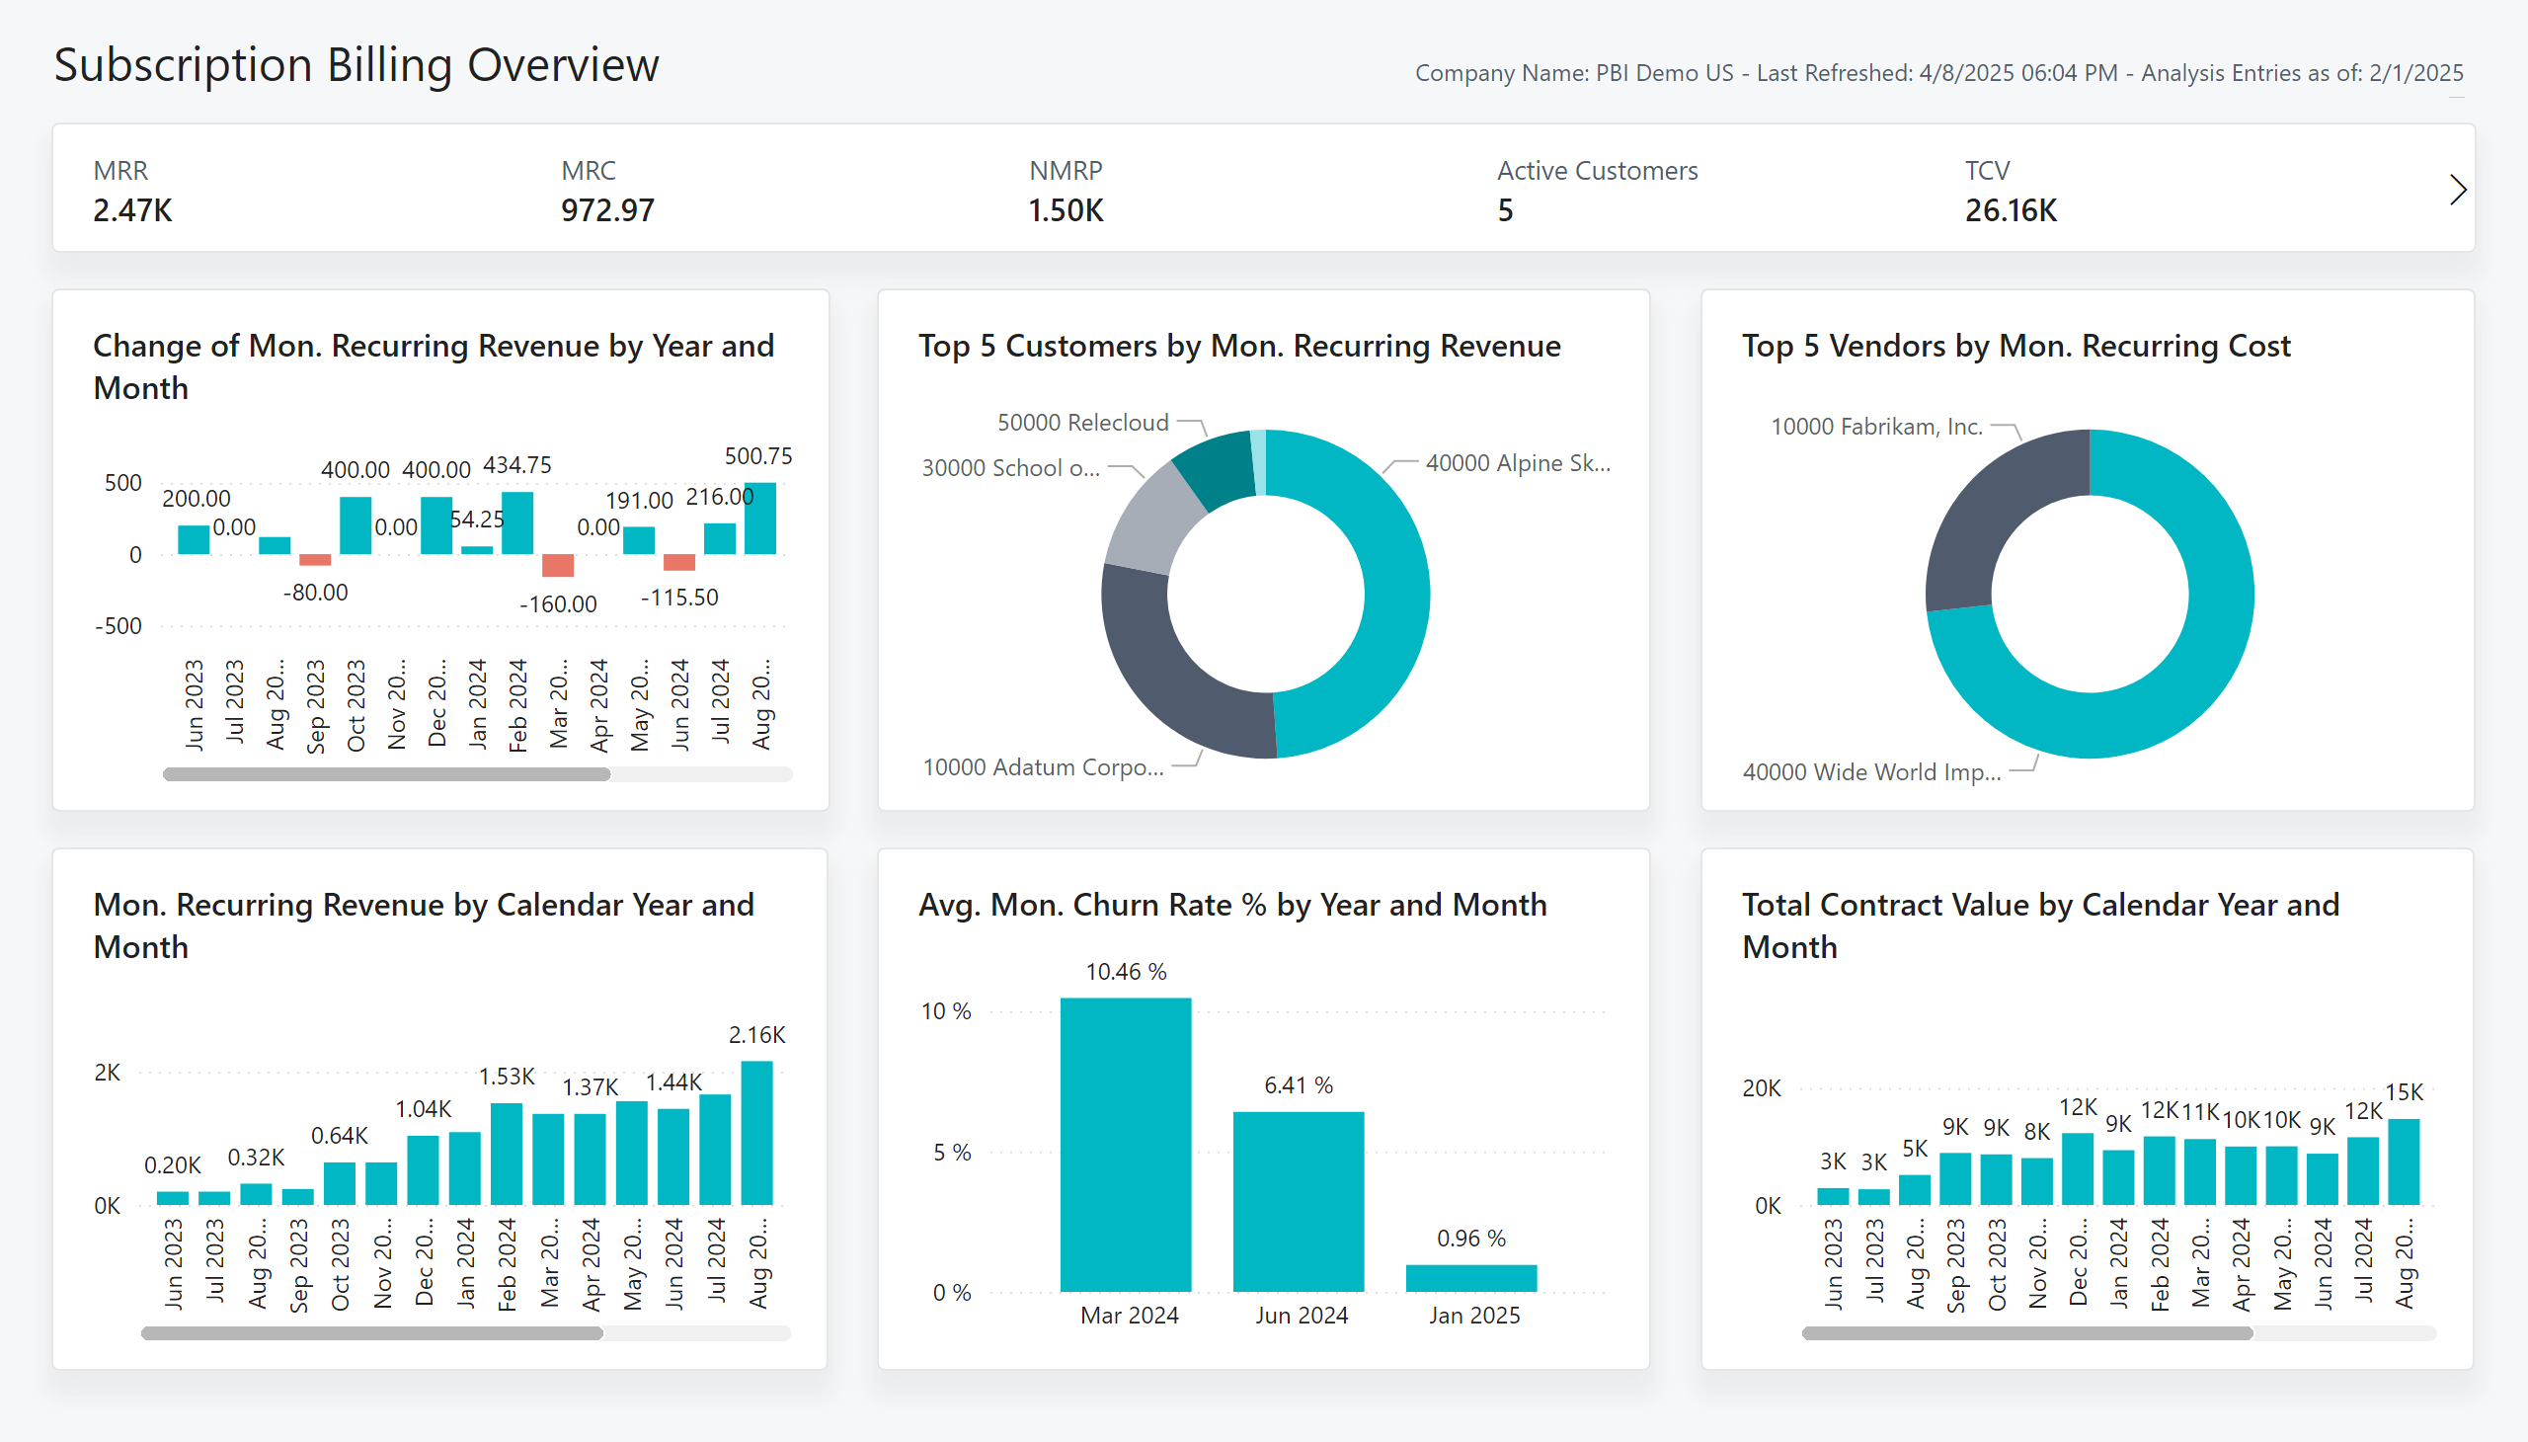

Subscription Billing Overview
Version 27
Version 28
Notes:
Subscription Billing Overview
Updated Layout of Overview page to align with other Embedded Business Central Reports and focus high-level analysis across Customers, Vendors and Package dimensions.
Updated Top 5 Customer and Vendor visuals to stacked bar charts for easier analysis of key revenue and cost sources.
Implemented KPI Cards to emphasize to key Subscription Billing measures.

Slide 7
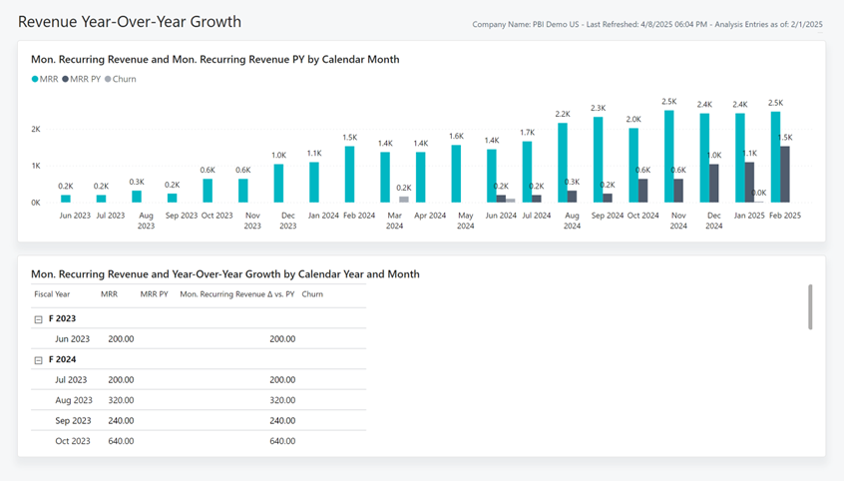
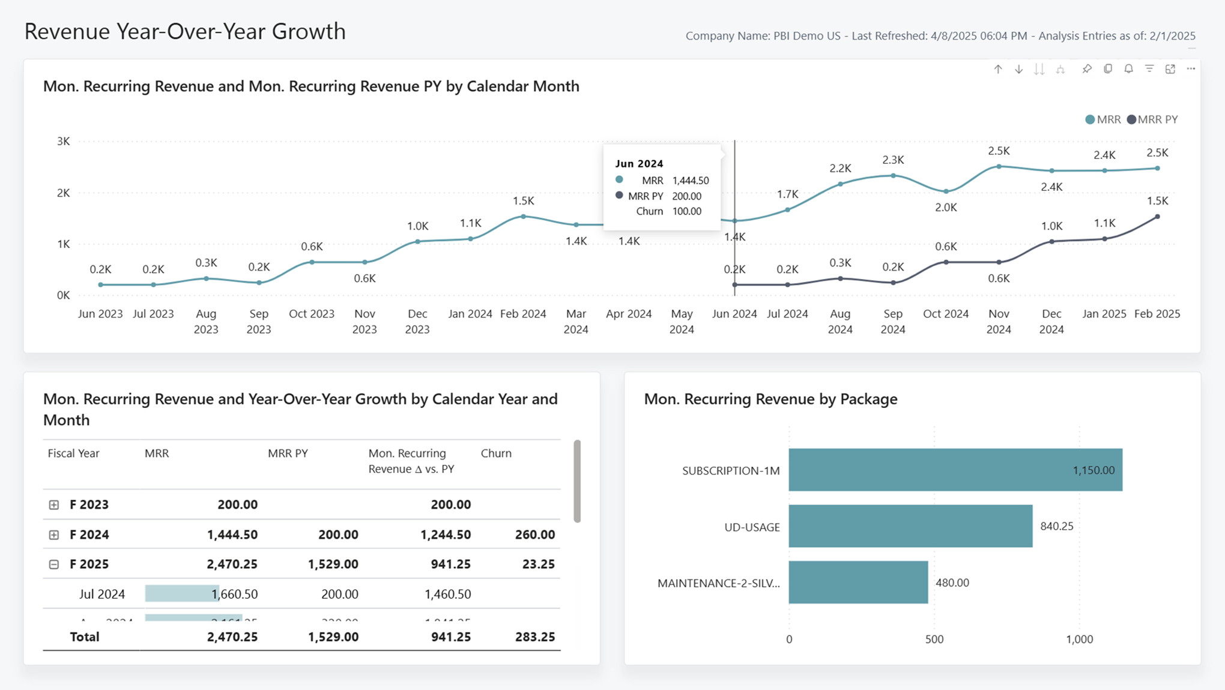
Revenue Year-Over-Year Growth
Version 27
Version 28
Notes:
Revenue Year-Over-Year
Added Mon. Recurring Revenue by Package for more dynamic analysis by Subscription Packages.
Added Tooltips to Recurring Revenue by Month visual to improve access to supporting measures.
Applied conditional formatting to emphasize key measures and updated time intelligence visual to a line chart to align with other reports.

Slide 8

Notes:
Revenue Year-Over-Year
Added Mon. Recurring Revenue by Package for more dynamic analysis by Subscription Packages.
Added Tooltips to Recurring Revenue by Month visual to improve access to supporting measures.
Applied conditional formatting to emphasize key measures and updated time intelligence visual to a line chart to align with other reports.

Slide 9
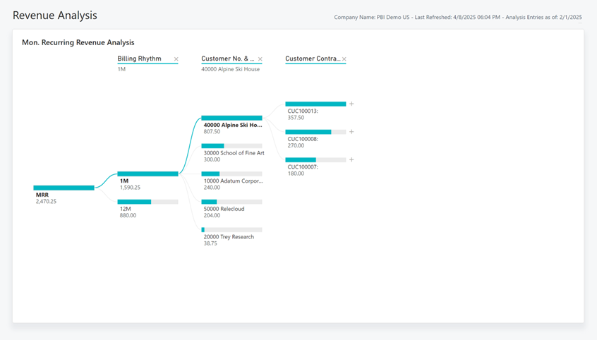
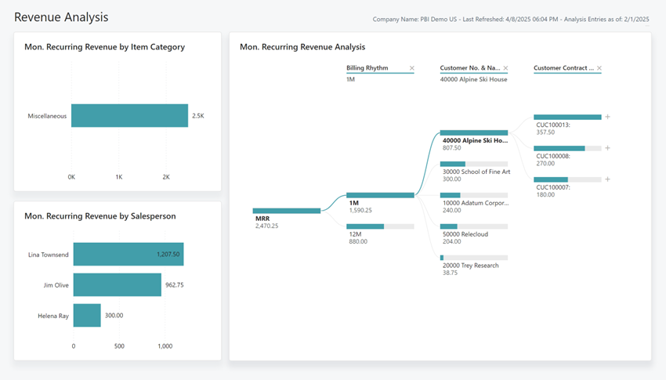
Revenue Analysis
Version 27
Version 28
Notes:
Revenue Analysis
Adding Item Category and Salesperson navigation visuals to the left of the decomposition tree for easier analysis and to align with the sales/purchasing reports.

Slide 10
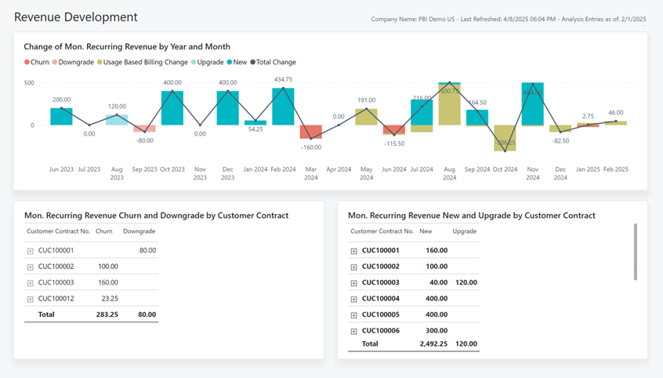
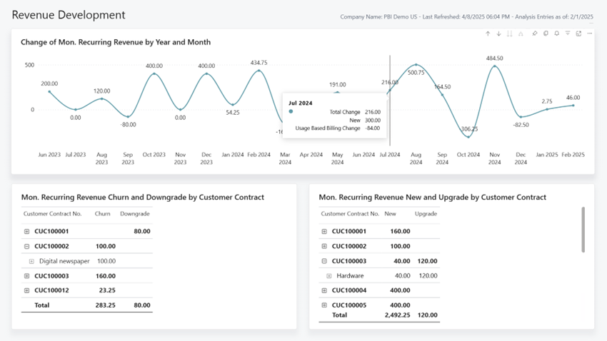
Revenue Development
Version 27
Version 28
Notes:
Revenue Development
Updated time intelligence visual to focus on total change measure and align with other Embedded Business Central reports
Moved additional measures to tooltips to improve clarity when analysing the Change to Monthly Revenue
Added support for Fiscal Calendar hierarchy to enhance flexibility when analyzing by date

Slide 11
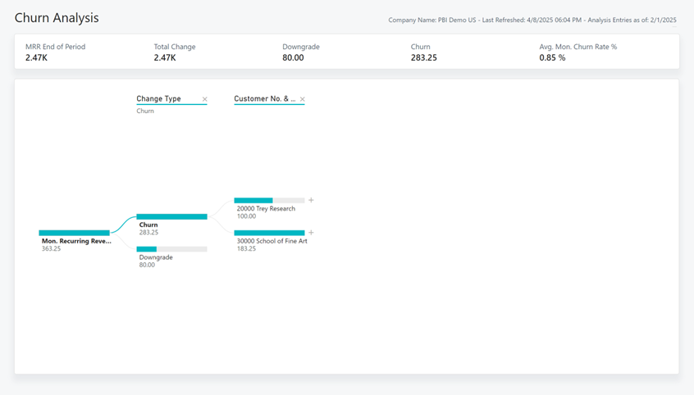
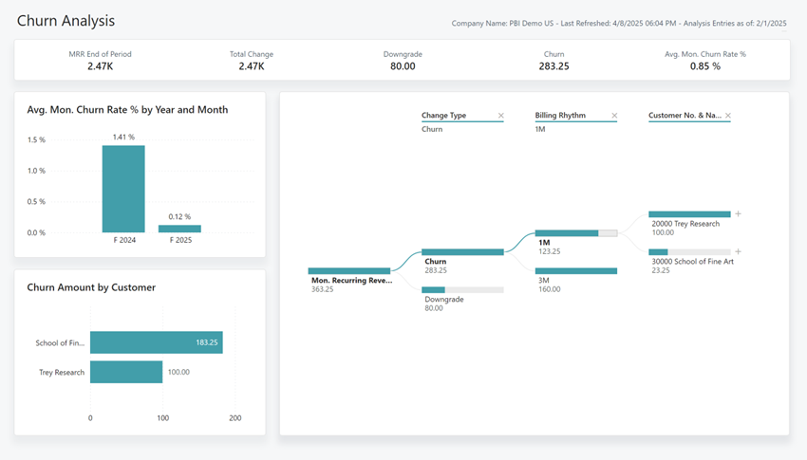
Churn Analysis
Version 27
Version 28
Notes:
Churn Analysis
Added Churn by Fiscal Period and Customer visuals to the left of the decomposition tree for easier analysis and to align with the sales/purchasing reports.

Slide 12
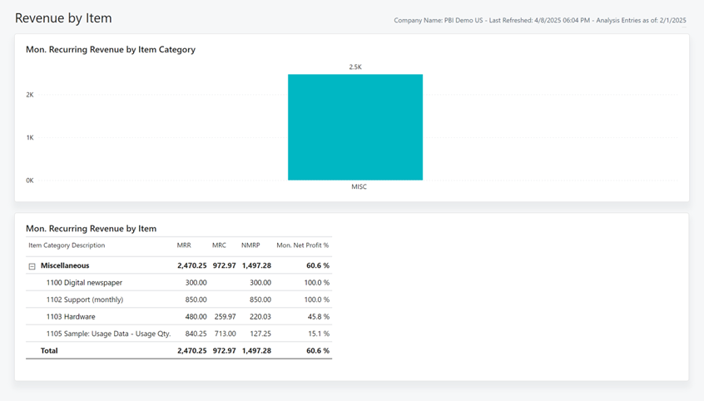
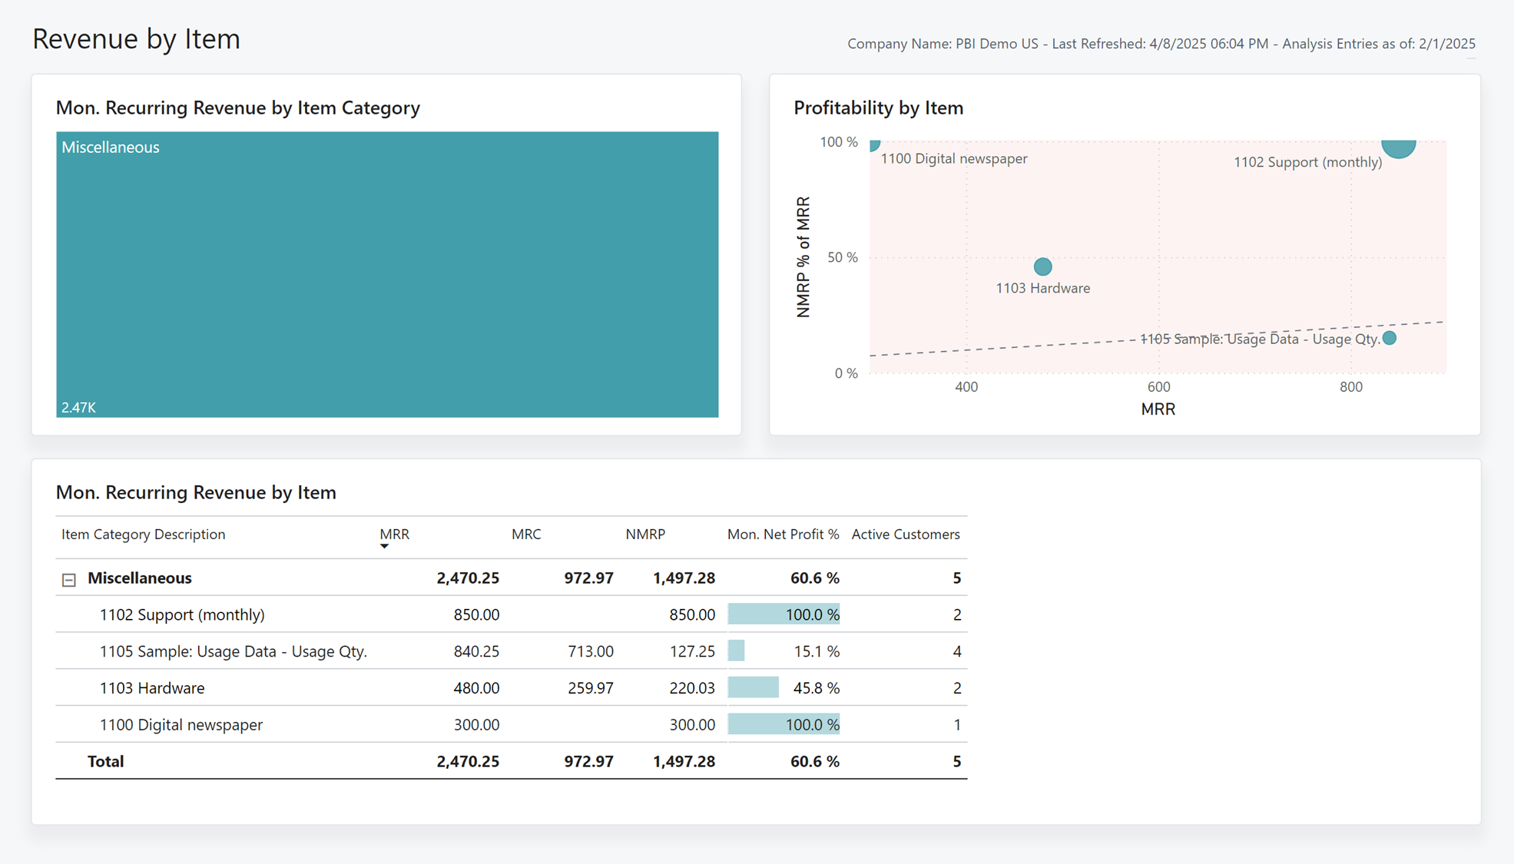
Revenue by Item
Version 27
Version 28
Notes:
Revenue by Item
Added Profitability by Item Category Scatter Chart, for more engaging visualization of Item Profit and Revenue performance
Added support for Item Category hierarchy to enhance flexibility when analysing by Item Categories
Updated Mon. Recurring Revenue by Item visual to Tree Map for consistency with other embedded reports.
Added conditional formatting to emphasize Monthly Profit % measure

Slide 13

Notes:
Revenue by Item
Added Profitability by Item Category Scatter Chart, for more engaging visualization of Item Profit and Revenue performance
Added support for Item Category hierarchy to enhance flexibility when analysing by Item Categories
Updated Mon. Recurring Revenue by Item visual to Tree Map for consistency with other embedded reports.
Added conditional formatting to emphasize Monthly Profit % measure

Slide 14
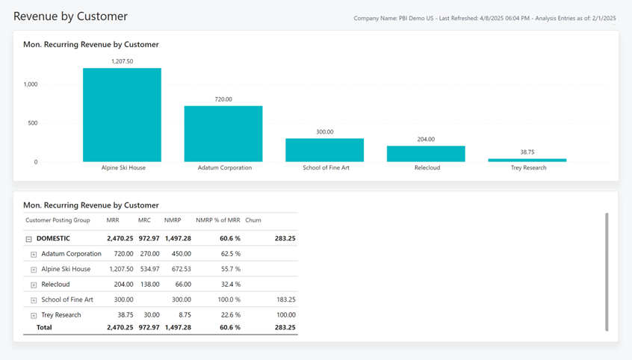
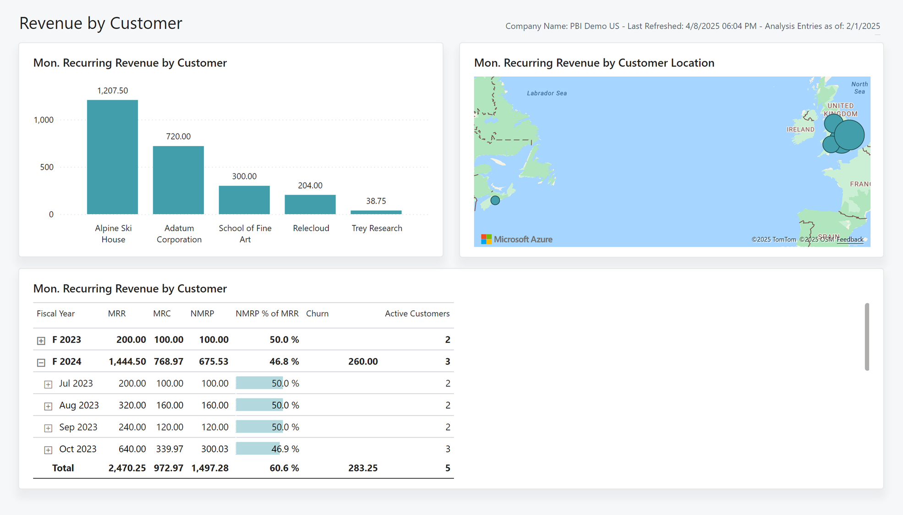
Revenue by Customer
Version 27
Version 28
Notes:
Revenue by Customer
Added Customer Location Map visual to improve subscription profit insights across customer demographics.
Added conditional formatting to emphasize key Monthly Net Profit % measure

Slide 15

Notes:
Revenue by Customer
Added Customer Location Map visual to improve subscription profit insights across customer demographics.
Added conditional formatting to emphasize key Monthly Net Profit % measure

Slide 16
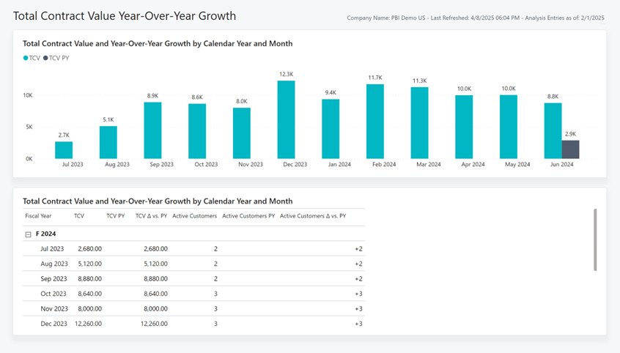
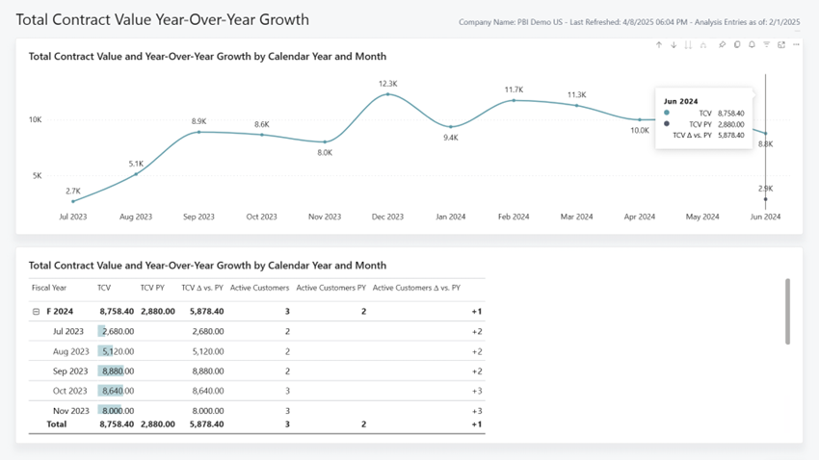
Total Contract Value Year-Over-Year Growth
Version 27
Version 28
Notes:
Total Contract Value Year Over Yeah Growth
Updated Total Contract Value by Calendar year visual to align with other Embedded Business Central Reports
Added Total Contract Change measure to tooltip to allow for easier analysis when comparing against previous year.
Added conditional formatting to matrix visual to emphasize Total Contract Value measure

Slide 17
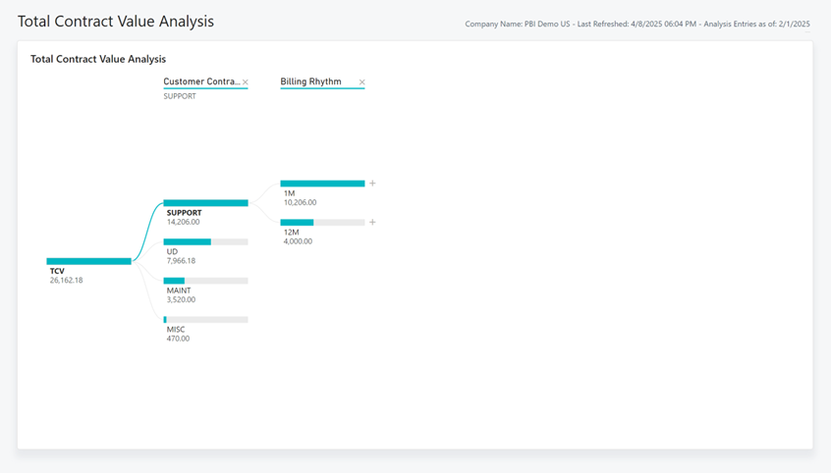
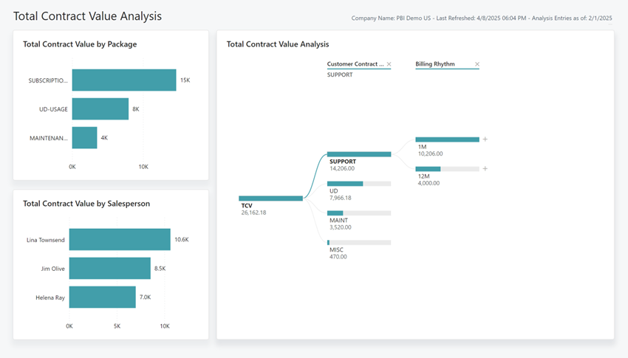
Total Contract Value Analysis
Version 27
Version 28
Notes:
Total Contract Value Analysis
Added Contract Value by Package and Salesperson visuals to the left of the decomposition tree for easier analysis and to align with the sales/purchasing reports.

Slide 18
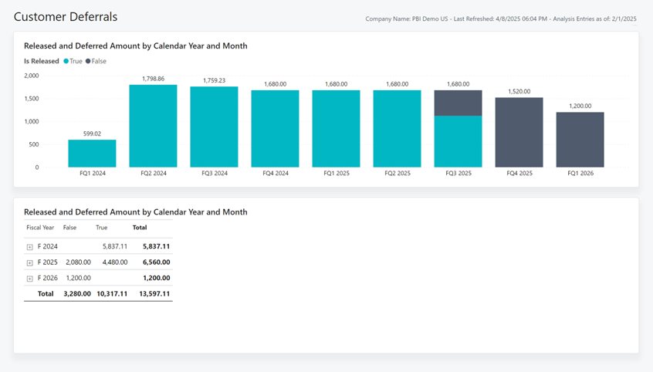
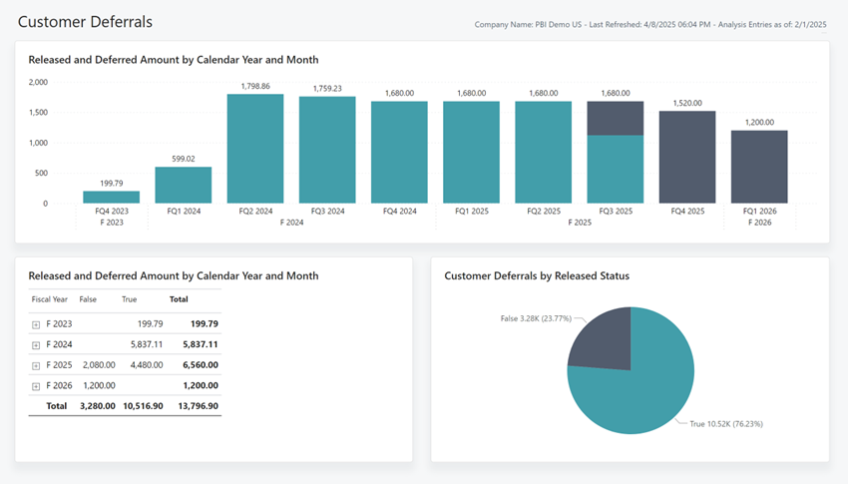
Customer Deferrals
Version 27
Version 28
Notes:
Customer Deferrals
Added Customer Deferrals by Released Status pie chart visual for easier analysis of total Customer Deferrals by status.

Slide 19
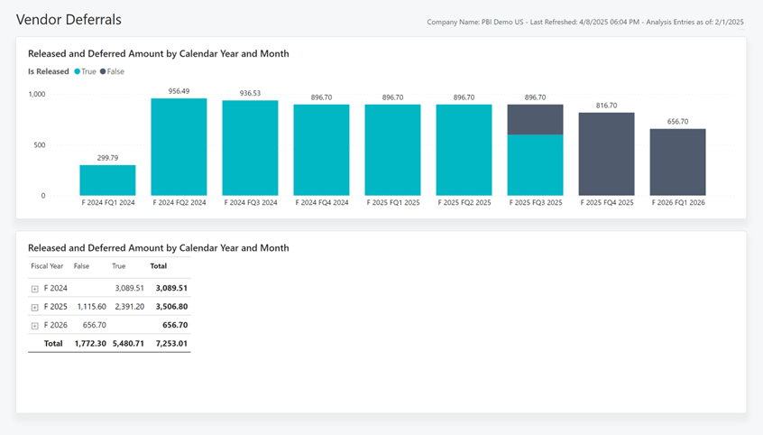

Vendor Deferrals
Version 27
Version 28
Notes:
Vendor Deferrals
Added Vendor Deferrals by Released Status pie chart visual for easier analysis of total Customer Deferrals by status.

Slide 20
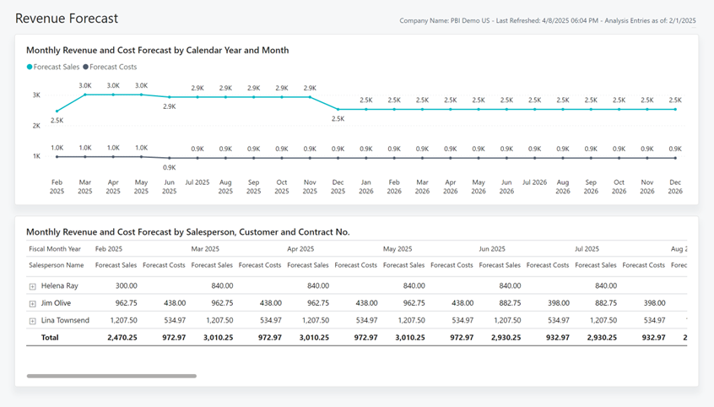
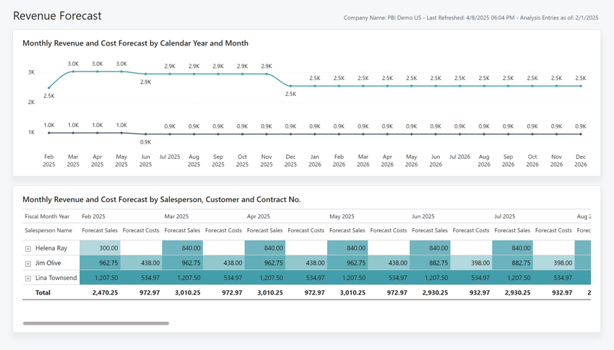
Revenue Forecast
Version 27
Version 28
Notes:
Revenue Forecast
Added conditional formatting to more effectively analyse revenue forecast trends and outliers, and align with sales app.

Slide 21
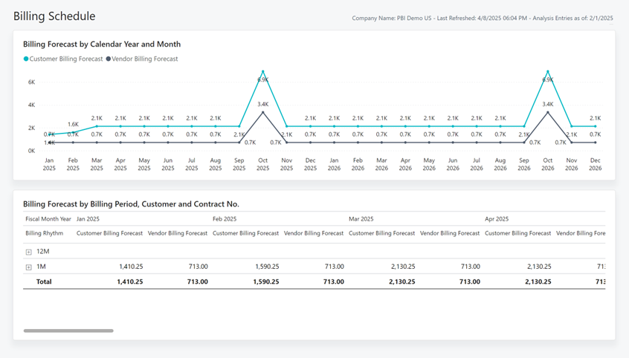
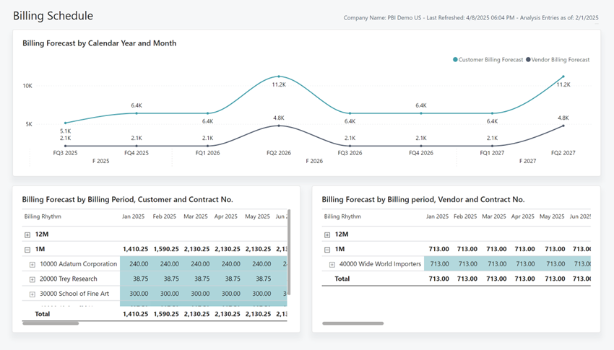
Billing Schedule
Version 27
Version 28
Notes:
Billing Forecast
Added dedicated Billing Forecast by Vendor table to improve clarity when analyzing Vendor and Customer forecasts.
Added conditional formatting to more effectively analyze billing forecast trends and outliers.

Slide 22
Enhanced Demo data (subscription billing)
Add more
Customer contracts
Vendor contracts
Transactions

Slide 23
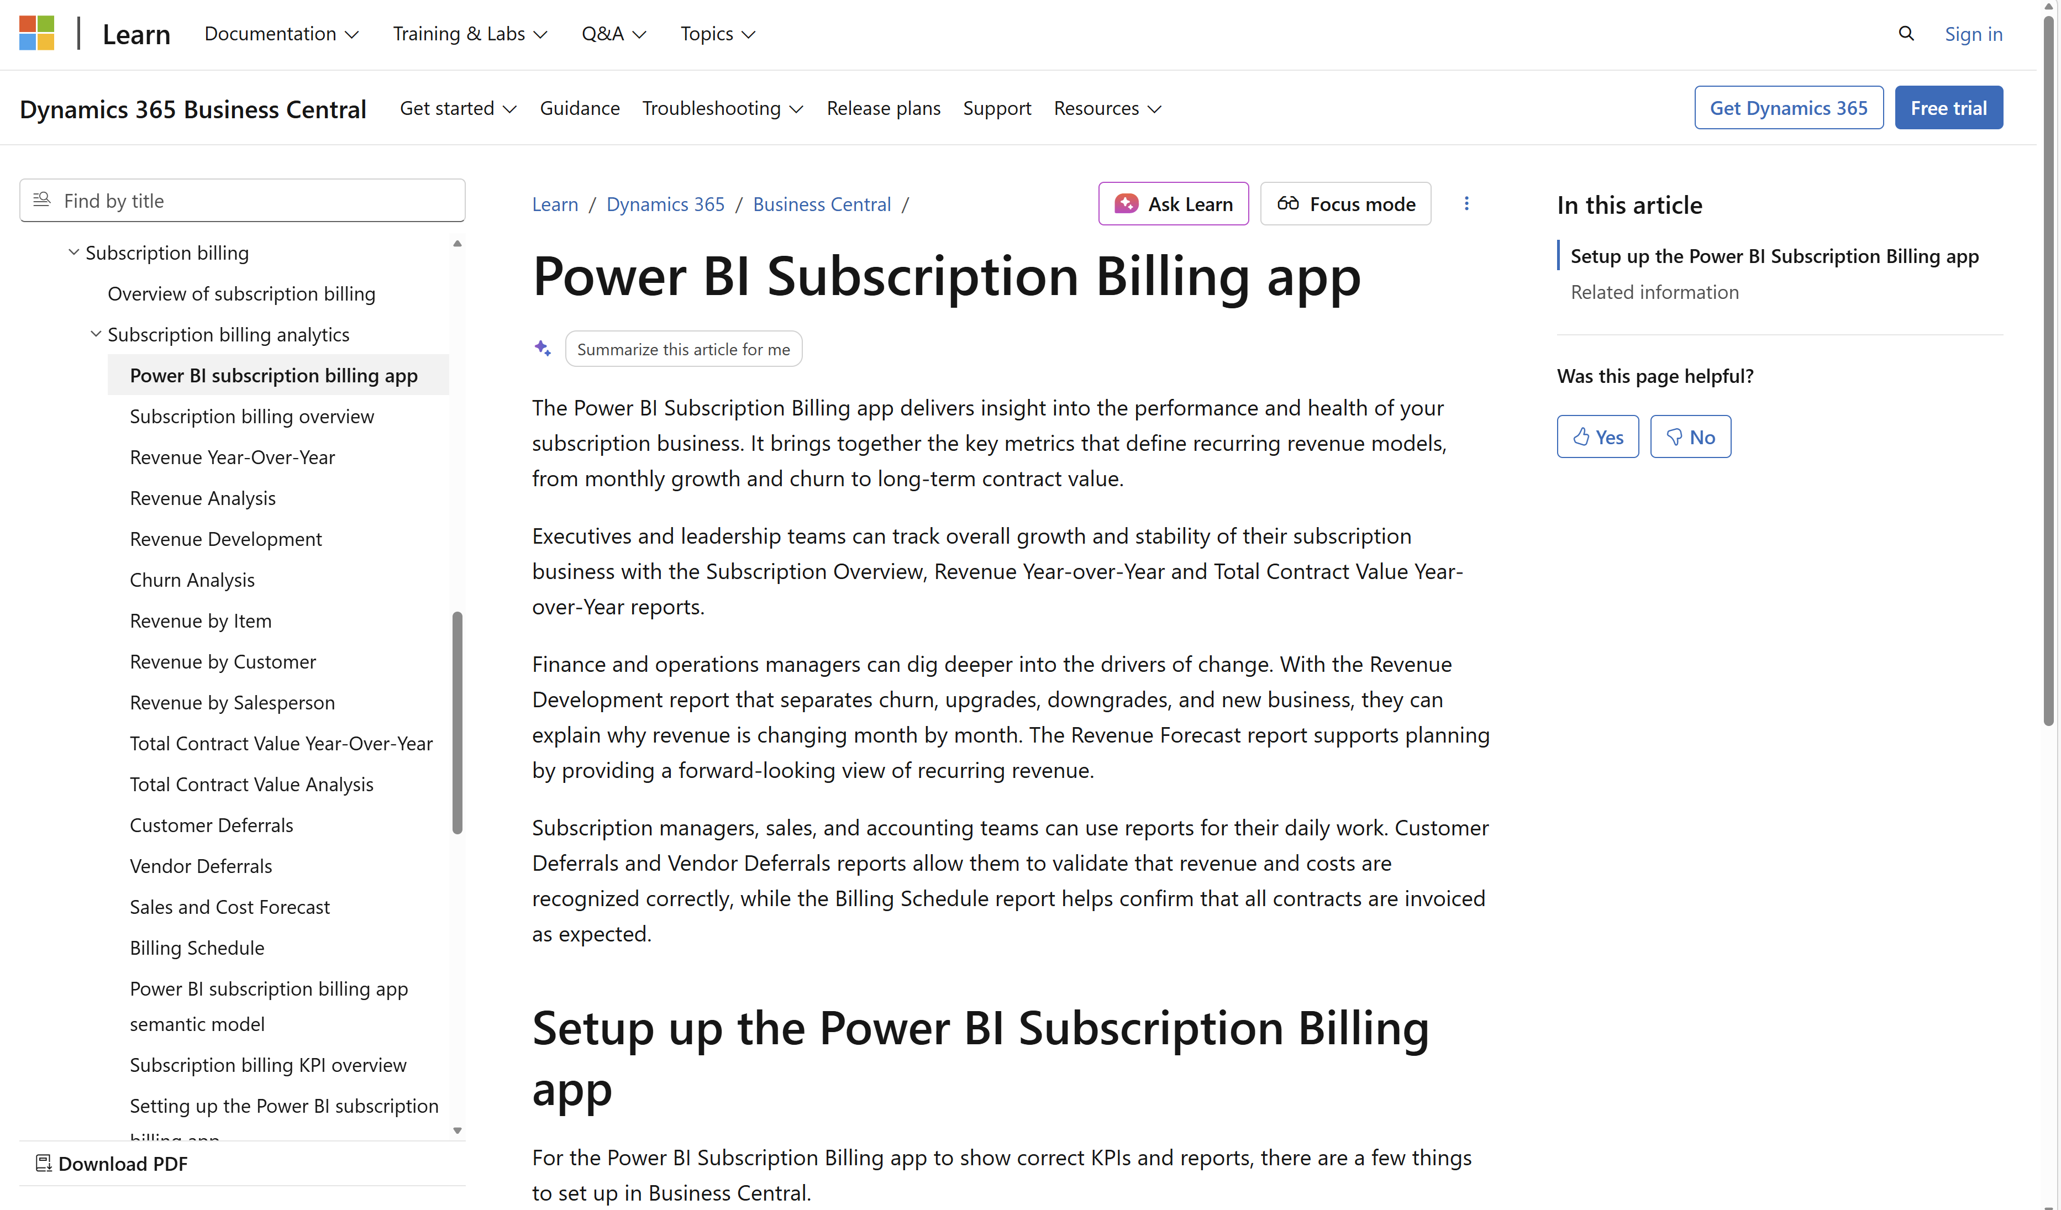
Want to learn more?

Slide 25
Related sessions
What's new: Enhanced sales analytics
What's new: Enhanced inventory analytics
What's new: Enhanced finance analytics
What's new: Enhanced Financial Reporting
What's new: Enhanced Power BI and Excel with Business Central
What's new: Enhanced Analysis Mode

Slide 26
General Business Central resources
Learn more!
Looking for resources?
Watch more on YouTube
aka.ms/BCAll
aka.ms/BCYouTube
Join Viva Engage to ask questions
Follow on LinkedIn
aka.ms/BCLinkedIn
aka.ms/BCVivaEngage
Join the office hours
Microsoft page for partners
aka.ms/BCOfficeHours
aka.ms/BCPartnerPortal

Slide 27



LinkedIn
Follow the weekly news and announcements
on the Microsoft Dynamics 365 Business Central page
aka.ms/BCLinkedIn

Slide 28

Watch more videos on YouTube
One-stop shop to watch Business Central videos:
  What is new
  Copilot and AI
  Short tips and tricks
  Technical deep dives
  Under the Hood podcast series
aka.ms/BCYouTube

Slide 29
THANK YOU

